Slide 1
Bank Telemarketing Campaign
Exploratory Data Analysis and Strategic Recommendation

Slide 2
Tables of Contents
Introduction to the Bank Telemarketing Campaign
Understanding the Dataset
Descriptive Statistics
Univariate Analysis
Bivariate Analysis
Categorical Variables Analysis
Temporal Analysis
Feature Engineering
Correlation Analysis
Outlier Detection and Handling

Slide 3
Introduction to the Bank Telemarketing Campaign
Objectives of the Campaign
Understand the bank's strategy to enhance revenue through a cost-efficient telemarketing campaign.
Importance of Term Deposits
Discuss how term deposits foster long-term relationships and secure capital.
Goals for Exploratory Data Analysis
Outline the EDA process to optimize the campaign's positive response rate.

Slide 4
Understanding the Dataset
Data Structure
Total Rows: 45,211
Total Columns: 20
Data Types: Primarily integers, floats, and objects (strings).
Data Integrity
Imputation was used for missing data to avoid losing valuable information, especially when the proportion of missing data was small.
Transformation and Capping were employed to handle outliers, mitigating their impact without discarding potentially valuable data.
Data Cleaning ensured that the dataset was consistent and ready for analysis, removing or correcting any misaligned or improperly formatted data.

Slide 5
Descriptive Statistics
Derive summary statistics (mean, median, standard deviation) for relevant columns.
 | Customer id | Age | Salary | Balance | Day | Duration | Campaign | Pdays | Previous
count | 45181.0000 | 45181.0000 | 45181.0000 | 45181.0000 | 45181.0000 | 45181.0000 | 45181.0000 | 45181.0000 | 45181.0000
mean | 22606.3073 | 40.9349 | 57005.0464 | 1362.6899 | 15.8072 | 258.1477 | 2.7634 | 40.1986 | 0.5804
std | 13051.4610 | 10.6165 | 32089.1634 | 3045.5845 | 8.3229 | 257.5512 | 3.0966 | 100.1341 | 2.3040
min | 1.0000 | 18.0000 | 0.0000 | -8019.0000 | 1.0000 | 0.0000 | 1.0000 | -1.0000 | 0.0000
0.25 | 11304.0000 | 33.0000 | 20000.0000 | 72.0000 | 8.0000 | 103.0000 | 1.0000 | -1.0000 | 0.0000
0.5 | 22605.0000 | 39.0000 | 60000.0000 | 448.0000 | 16.0000 | 180.0000 | 2.0000 | -1.0000 | 0.0000
0.5 | 22605.0000 | 39.0000 | 60000.0000 | 448.0000 | 16.0000 | 180.0000 | 2.0000 | -1.0000 | 0.0000
0.75 | 33909.0000 | 48.0000 | 70000.0000 | 1428.0000 | 21.0000 | 319.0000 | 3.0000 | -1.0000 | 0.0000
max | 45211.0000 | 95.0000 | 120000.0000 | 102127.0000 | 31.0000 | 4918.0000 | 63.0000 | 871.0000 | 275.0000

Slide 6
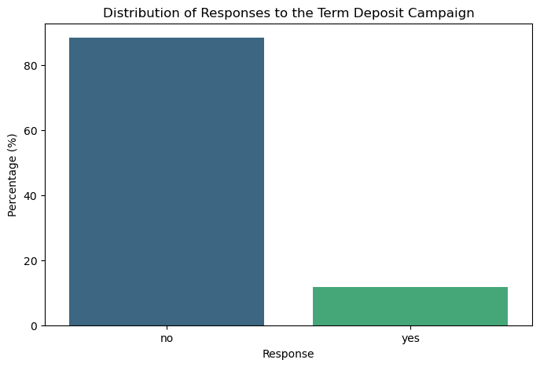
Examine the distribution of the target variable, indicating responses to the term deposit campaign.
Response Distribution
No: 88.30% of the contacts did not result in a term deposit.
Yes: 11.70% of the contacts did result in a term deposit.

Slide 7
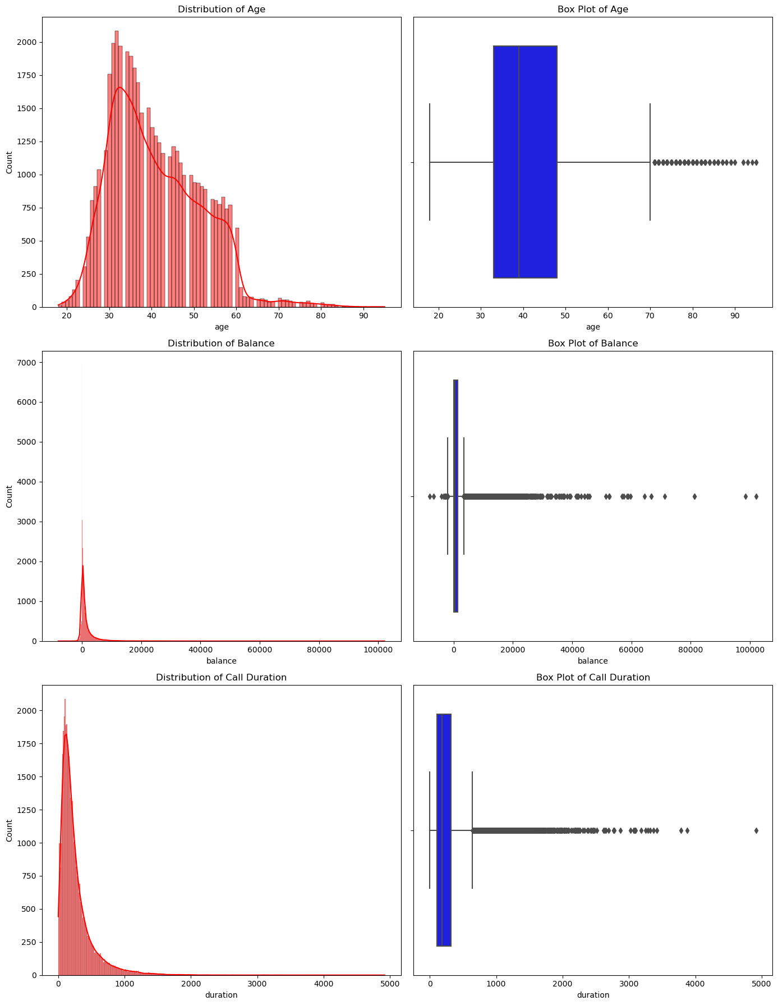
Univariate Analysis
Age:
H0istogram: The distribution is somewhat right-skewed, with a concentration of clients in the 30 to 40 age range.
Box Plot: Indicates a few outliers in the upper age range, showing that there are some clients significantly older than the main age group.
Balance:
Histogram: This is highly right-skewed, suggesting that while most clients have lower balances, a few have very high balances, likely influencing the mean.
Box Plot: There are many outliers on the higher end, indicating some clients have exceptionally high balances compared to the majority.
Call Duration:
Histogram: Also right-skewed, most calls are relatively short, but there are calls that are much longer than typical, affecting the average.
Box Plot: There are numerous outliers indicating that some calls were substantially longer than most others.

Slide 8
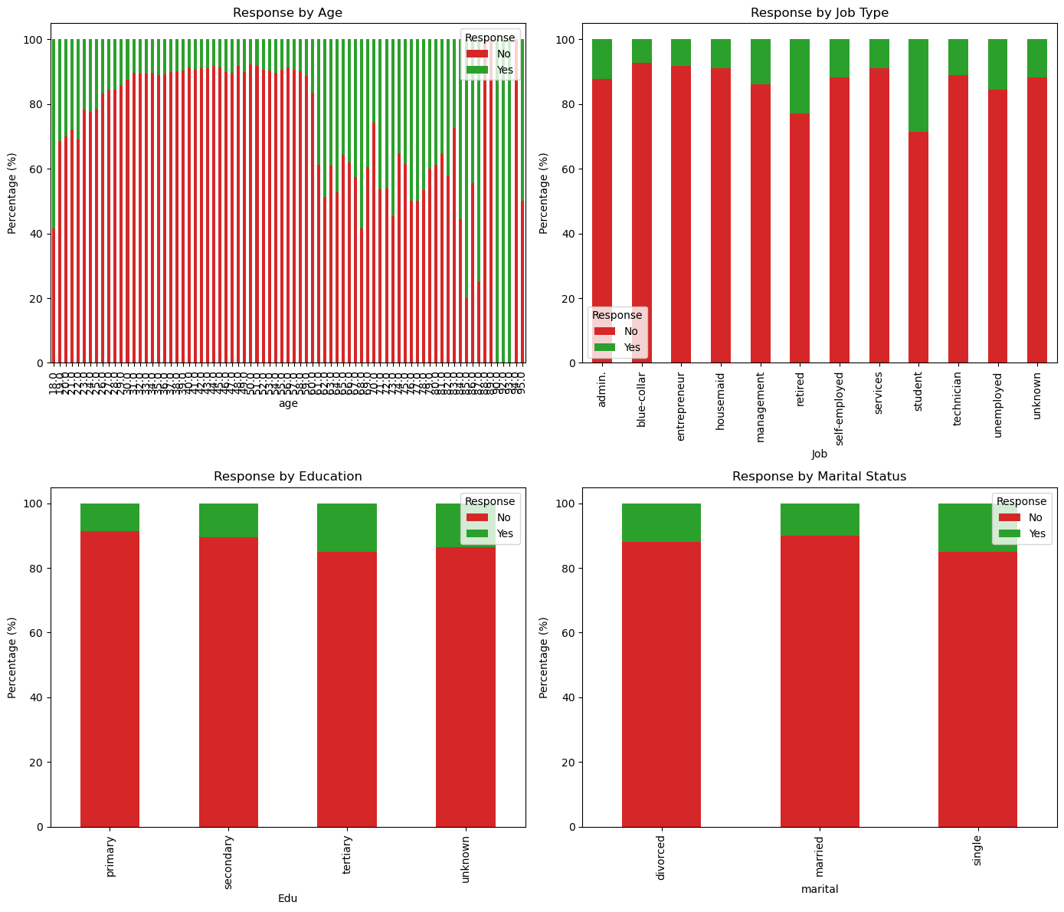
Bivariate Analysis

Slide 9
Bivariate Analysis
Response by Age:
The chart illustrates the count of responses across different age groups. Younger and older age groups show a relatively higher count of 'Yes' responses compared to middle-aged groups.
Response by Job Type:
Different job types show varying counts of positive and negative responses. Students and retired individuals again appear to have a higher proportion of 'Yes' responses relative to their total number, while blue-collar jobs and services have a higher proportion of 'No'.
Response by Education:
Clients with tertiary education show a higher count of positive responses, aligning with the previous heatmap results, indicating a greater likelihood of agreeing to term deposits.
Response by Marital Status:
Single and divorced clients exhibit a higher count of positive responses compared to married clients, which could be an area of interest for targeted campaigns.

Slide 10
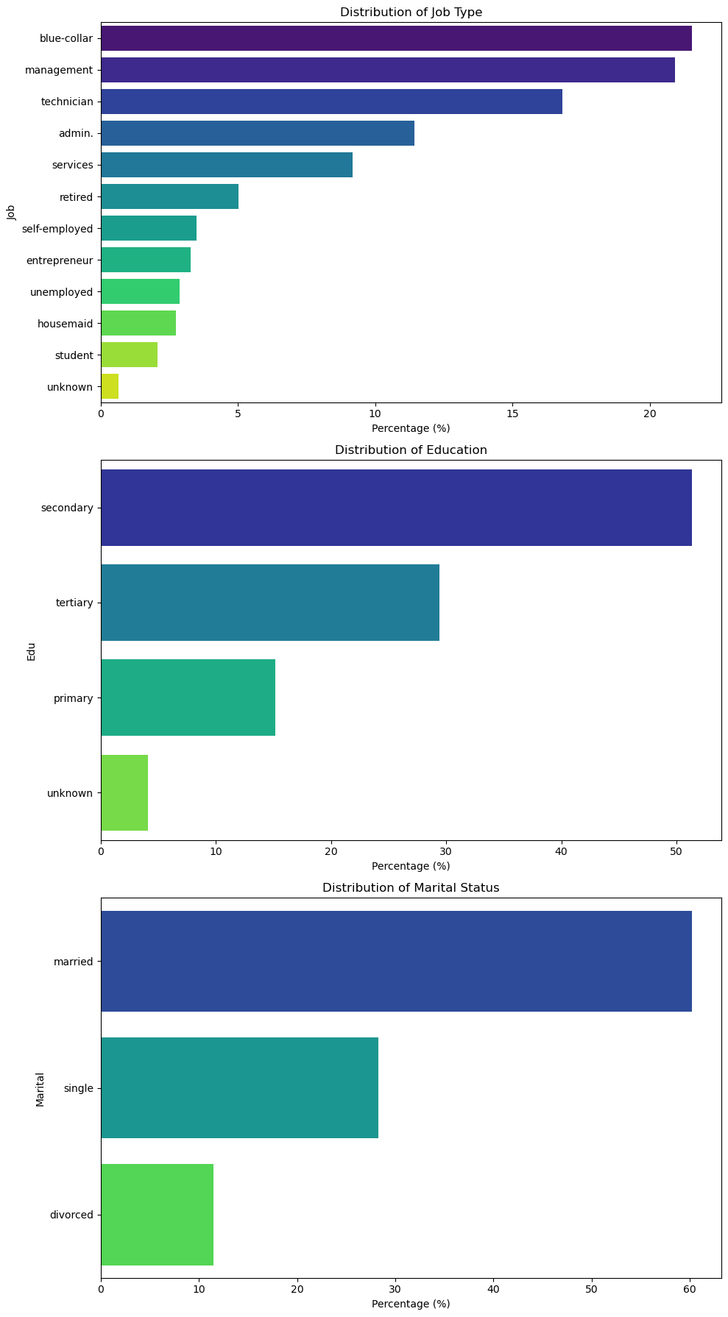
Categorical Variables Analysis
Distribution of Job Type:
Management, Blue-collar, and Technician jobs are the most common, making up a significant percentage of the dataset. Students and unemployed represent smaller fractions. Understanding these distributions can help tailor marketing strategies to the most prevalent job categories.
Distribution of Education:
Secondary education is the most common, followed by tertiary and then primary. This indicates a broad range of educational backgrounds among the clients, with a significant portion having at least secondary education.
Distribution of Marital Status:
The majority of the dataset consists of married individuals, with single and divorced making up a smaller proportion. This could influence how products like term deposits are marketed, considering family financial planning needs

Slide 11
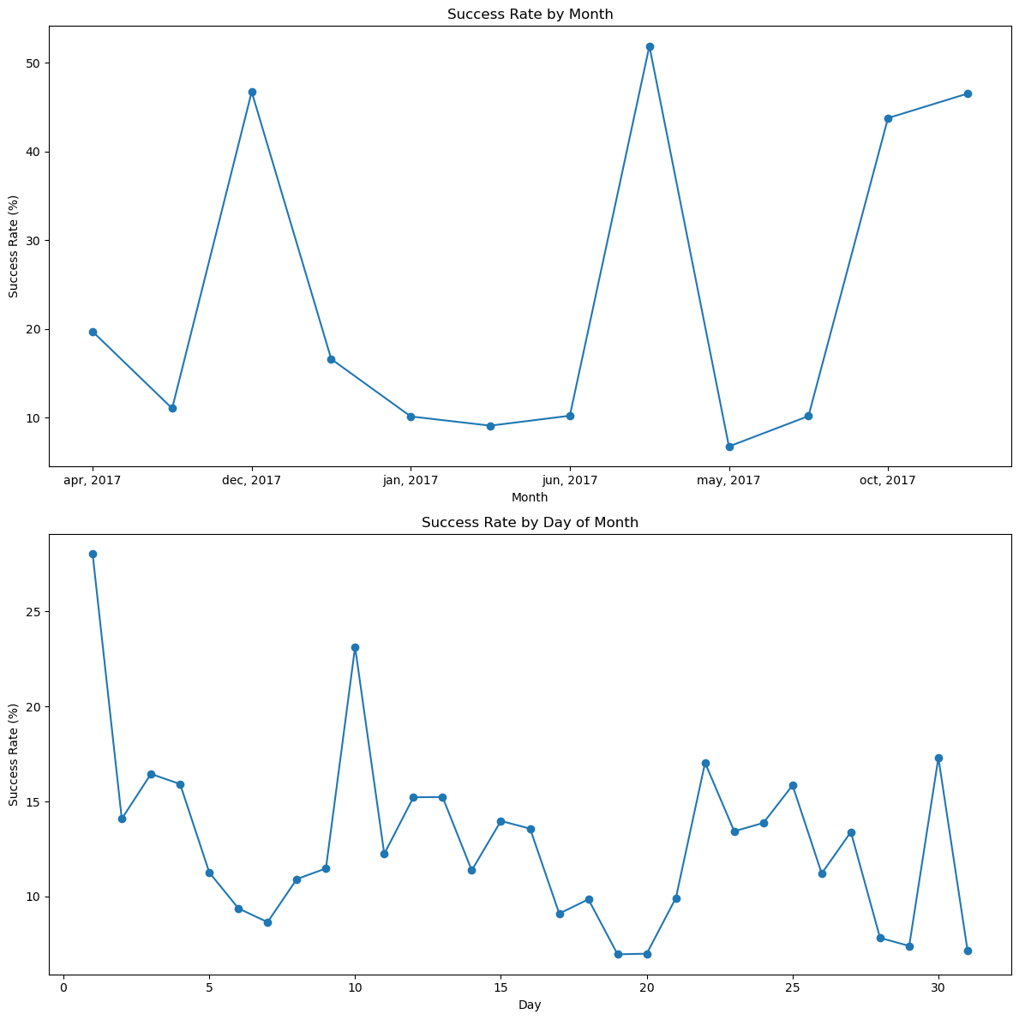
Temporal Analysis
Success Rate by Month:
There are distinct variations in success rates across different months. Months like March, December, September, and October show higher success rates, possibly due to seasonal factors or the timing of financial planning decisions by customers.
Months such as May, which has a higher volume of calls (as seen in previous distributions), shows one of the lower success rates, suggesting that a saturation of contacts might be counterproductive.
Success Rate by Day of Month:
The success rate appears to fluctuate throughout the month without a clear, consistent pattern. However, there are subtle peaks and troughs which could be related to payday cycles or other periodic financial behaviors.
There does not seem to be a strong, consistent trend indicating a particular day being significantly more effective for the campaign.

Slide 12
Feature Engineering
New Features Created:
Age Groups:
Under 30: 15.55%
30-40: 39.14%
40-50: 24.86%contact, poutcome, month, age_group, and income_category.
50-60: 17.83%
Over 60: 2.62%
This categorization can help in analyzing the responsiveness to the campaign across different age groups.
2. Income Categories:
Low: 29.87%
Lower Middle: 0.00% (no entries for this category)
Middle: 36.73%
Upper Middle: 9.19%
High: 20.92%
Very High: 3.29%
This segmentation might reveal preferences for term deposits based on income levels.
I've applied one-hot encoding to categorical variables such as Job, Edu, marital, contact, poutcome, month, age_group, and income_category.
This transformation converts these categories into a format suitable for modeling, where each category is represented as a binary feature.

Slide 13
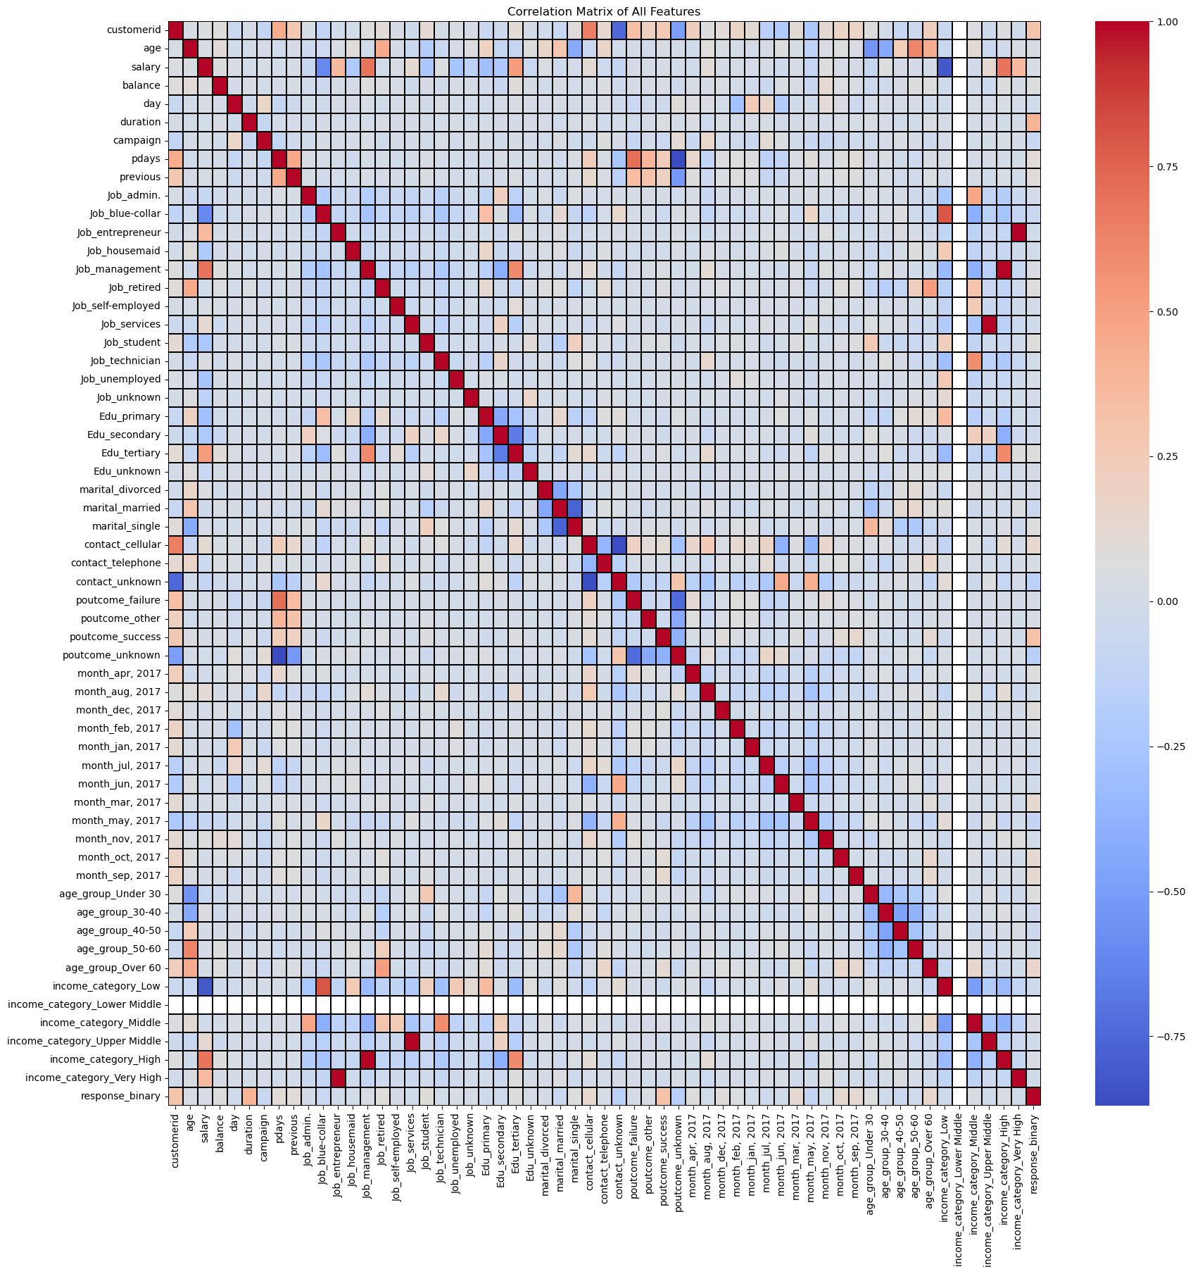
Correlation Analysis

Slide 14
Correlation Analysis
Key Positive Correlations with Response
Duration:
The length of the call shows the strongest positive correlation with a successful response (0.395), suggesting that longer calls might lead to higher success rates.
Poutcome_success:
Previous campaign outcomes labeled as 'success' have a significant positive correlation (0.307), indicating that past success is a strong predictor of future results.
CustomerID:
Surprisingly, there is a moderate correlation (0.296), which might indicate a trend or pattern in how data was collected or recorded.
Age Group 'Over 60’:
Older individuals have a notably higher correlation (0.156) with positive responses, supporting targeted marketing efforts towards this age group.
Contact Method 'Cellular’:
Using cellular phones for contact correlates positively (0.136) with successful outcomes.
Months with High Success Rates:
Specific months like March, September, and October also show higher positive correlations, aligning with the earlier temporal analysis that suggested seasonal impacts on campaign effectiveness.
Multicollinearity:
The heatmap reveals some multicollinearity among dummy variables created from the same categorical variable, which is expected due to one-hot encoding. High correlations between different job types, education levels, and contact types may need to be addressed in modeling to avoid overfitting and improve model interpretability.
Missing Values:
income_category_Lower Middle has no correlation value (NaN) due to the absence of entries in this category, which might require further handling.

Slide 15
Outlier Detection and Handling
Outliers were identified in the following numerical features based on the Interquartile Range (IQR) method:
Age: 487 outliers
Balance: 4,728 outliers
Duration: 3,232 outliers
Handling Strategies
Age:
Given the nature of age data and the relatively small number of outliers, it might be best to leave these as-is, assuming they represent legitimate age data.
Balance:
The large number of outliers suggests high variability in client balances. We could cap the balances at a certain threshold determined by the upper bound, or transform this variable to reduce skewness, such as applying a logarithmic transformation where values are non-zero.
Duration:
As this is the most strongly correlated feature with the response, care should be taken. Outliers might be capped at an upper bound, or similar to balance, a transformation could be applied to reduce the effect of extreme values.

Slide 16
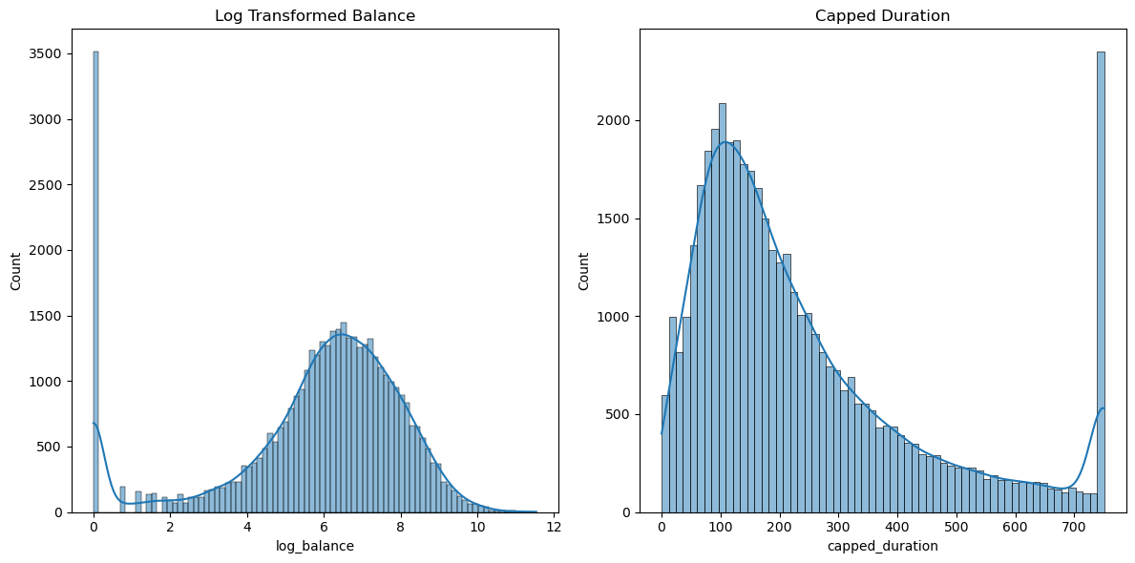
Outlier Detection and Handling
Log Transformed Balance:
The transformation has normalized the distribution of balance, reducing the skewness significantly. This should help mitigate the impact of extreme values in the dataset.
Capped Duration:
By capping duration at its 95th percentile, we've managed to limit the influence of extremely long calls while preserving the distribution's overall shape. This should reduce the effect of outliers on model performance without significantly distorting the underlying data.
It appears there was an issue with taking the logarithm of zero or negative values in the balance, which I initially tried to handle by adding 1. This method usually adjusts for zero values, but negative balances can still cause problems.
Next Steps:
Reassess Negative Balances: For negative balances, we might need to adjust the transformation method or handle these values more appropriately.
Model Re-evaluation: With the outliers addressed, it's a good practice to re-evaluate model performance to see if these adjustments have improved the predictions.

Slide 17
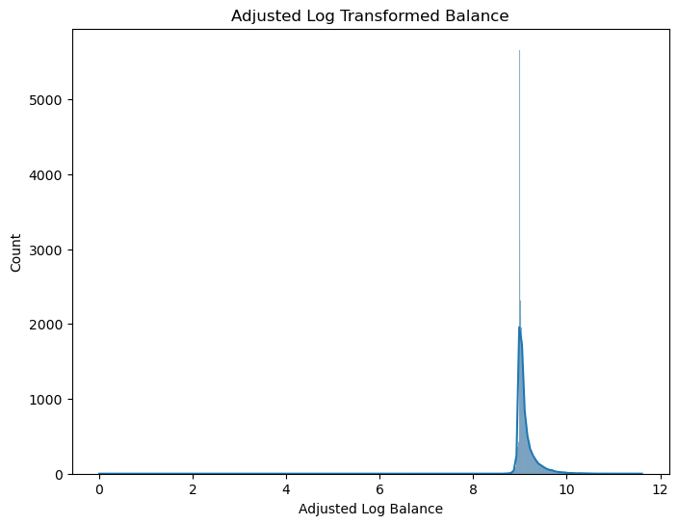
Outlier Detection and Handling
This transformation should help in reducing the impact of outliers and enhancing the model's ability to handle the wide range of balance values more effectively.

Slide 18
Logistic Regression model
Model Evaluation Summary:
Accuracy: 95.64%
This is the proportion of total correct predictions (both true positives and true negatives) among the total number of cases examined. High accuracy indicates that your model performs well on this dataset.
Confusion Matrix:
True Negatives (TN): 7853 - The number of correctly predicted non-responses.
False Positives (FP): 95 - The number of non-responses incorrectly labeled as responses.
False Negatives (FN): 299 - The number of responses that were not identified.
True Positives (TP): 790 - The number of correctly predicted responses.
The matrix shows that your model is quite robust in predicting non-responses but could be improved in detecting responses, as seen in t the false negatives.
Precision, Recall, and F1-Score:
Precision (for 'yes' responses): 0.89 - This indicates a high precision rate, meaning that when your model predicts a response, it is correct about 89% of the time.
Recall (for 'yes' responses): 0.73 - This shows that of the actual responses, your model correctly identifies about 73%. There’s room to improve recall, perhaps by focusing on reducing false negatives.
F1-Score (for 'yes' responses): 0.80 - The F1-score is a balance between precision and recall, and a score of 0.80 is quite good but highlights that there might be a balance to strike between optimizing either precision or recall further.
ROC-AUC Score: 0.9584
The ROC-AUC score being close to 1 indicates excellent model performance, showing a good measure of separability between the classes.

Slide 19
Conclusions and Recommendations
Campaign Optimization: Marketing efforts can be optimized by targeting demographic segments more likely to respond, such as the younger and older age groups, and tailoring messages to individuals in different job roles and with different educational backgrounds.
Strategic Timing: Consideration of the temporal effectiveness of campaigns can lead to better scheduling, avoiding periods with historically lower success rates.
Continuous Monitoring: Regular updates and analysis of campaign data can help in quickly adjusting strategies based on real-time feedback and emerging trends.
Customer Interaction: The analysis suggests that longer, more engaging conversations (within reasonable limits) could lead to higher conversion rates, emphasizing the quality of interaction.
This project illustrates the power of data-driven decision-making in enhancing marketing effectiveness. By continuously learning from the data and adapting strategies accordingly, banks can significantly improve the efficiency of their marketing investments.

